Slide 1
Non-Invasive point of care ECG signal detection and analytics for cardiac diseases
Bachelor Thesis project
Presented by
Shubham Kumar Gupta (180107058)
Mentors
Prof. Dipankar Bandyopadhyay
Ass. Prof. Resmi Suresh
Sahil Jagnani

Slide 2
Content
Basic Analysis
What’s ECG? ¹
How ECG Signal Look Like? ¹²
Why is it important to measure ECG? ¹
Depth Analysis
Structure & Functioning of Heart ²
Visualizing Electric Pulses in Heart ²
Stages of ECG ²
ECG Cycles ²
How ECG is done? ²
Fluctuations in ECG ²
Different Cardiac Disease ECG Analysis ²
Market and Device Analysis
Devices that can measure ECG ¹
Limitations: Devices that can measure ECG ¹
Modern Devices that can measure ECG ¹
Working of Mawi Band ¹
DIY available? ¹
Publications & Library ¹
Statistics & Market Analysis ¹
Tools Analysis
Bio-Sensors ²
ML/DL & Sample Dataset Explore²
DIY ²
Ideation (not sure this will work) ²
What’s for me then? ¹
Timeline ¹²
bit.ly/btp2Aug
Prev ppt: bit.ly/btp21Aug

Slide 3
Content
Recap
Case Study
Apple’s ECG Watch Single Lead
Kardia 6L
Sanket’s 12Lead
Constraints
Hardware Analysis
Heart Beat Sensor Working
Oximeter Sensor (BPM & SpO₂ Level)
Sensor MAX30100
Grove Finger-Clip Heart Rate Sensor
Working Principle
Source of Noise
Block Diagram
Hardware Setup1( Single Lead, Low Accuracy, Alert only risk)
Circuit Diagram
Cost Estimation
Hardware Setup2(12 Lead, High Accuracy, electrode straps, Easy)
Circuit Diagram
Cost Estimation
Process Flow
Data Collection
Types of data collected
Resources
Timeline
bit.ly/btp2Aug
Prev ppt: bit.ly/btp21Aug

Slide 4
DISCLAIMER
I have no intention to harm any products related to Apple or any company!
No userbase is targeted or tried to offended using this!
I am studying them just for research and educational purposes.

Slide 5
Recap
Important Diagnostic Tool
The electrocardiogram (ECG or EKG ), is measure of electrical activity associated with heart function.
Graph of an ECG signal can indicate abnormalities in a patient’s cardiac health.
ECG voltage levels monitored at the skin’s surface are less than 5mV in amplitude.
ECG is printed on a rectangular paper
Heart Anatomy and functioning
It has 4 chambers and 4 valves
Pumps impure blood from body to lungs and then lungs to body
Electric pulses on heart is due to varying electrolyte concentrations creating dipole moment and generating curve showing gradient
SA node -> Atria muscle fibers -> AV Nodes -> His Bundles -> Purkinje fibers->spreading to ventricular myocardium
ECG Interpretation
Its made up of P wave, QRS complex, and T wave
Abnormalities can generate J, U, F waves
ECG has total of 12 Leads (6-Chest Leads, 6-Limb Leads)
Total of 10 electrodes (1 ground) is placed over body
Fluctuations in ECG
Instrumentation Setup
How to take ECG
Biosensors
Limitations
Economics

Slide 6
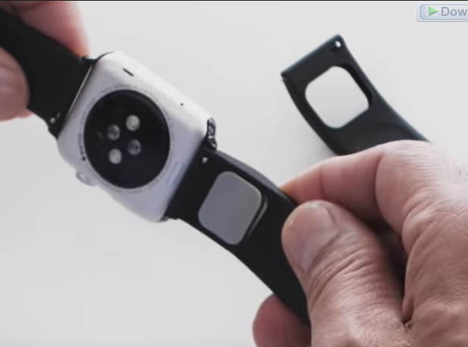
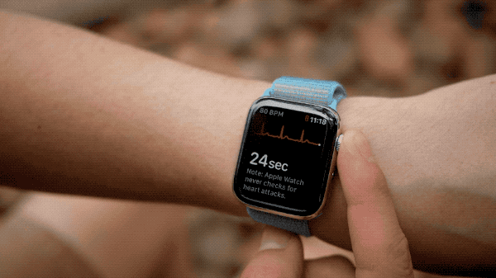
Case Study: Apple’s ECG Watch/Kardia Band
Purchased & Transformed : AliveCor Band (Kardia is a product of AliveCor)
ECG any time (30 seconds wait time)
Results on ECG app
Types of ECG (SINGLE LEAD CANNOT DETECT ANYTHING ELSE?)
Sinus rhythm (uniform 50-100 BPM) ¹
Atrial fibrillation (APPLE needed 2 versions to do this !)
Version 1: can track AF till 50-120 BPM¹
Version 2: can track AF till 50-150 BPM²
Low or high heart rate
Version 1: can track HB <50 or >120 BPM¹
Version 2: can track HB <50 or >150 BPM²
Inconclusive
Heart Rate is from 100-120 BPM but not Atrial Fibrillation¹
Recording cannot be classified ¹
Wearing Pacemaker? ¹
Poor Recording¹
Alivecor Band watch
Source: alivecor.com
Showing working of apple series 4 watch
Source:apple.com

Slide 7
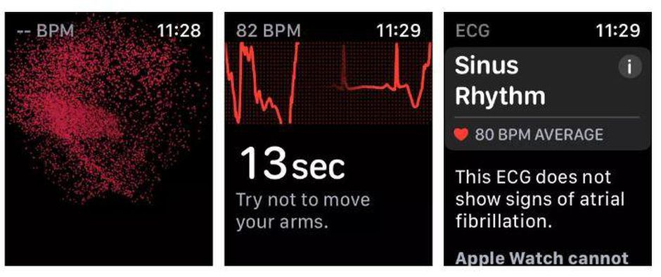
Case Study: Apple’s ECG Watch
Rest your arms on a table or in your lap while you take a recording. Try to relax and not move too much.
Make sure that your Apple Watch isn’t loose on your wrist. The band should be snug, and the back of your Apple Watch needs to be touching your wrist.
Clean & Dry
Move away from any electronics that are plugged into an outlet to avoid electrical interference.
Liquid-free contact is required for the ECG app to work properly
THINGS TO CONSIDER!!
The ECG app cannot detect a heart attack. If you ever experience chest pain, pressure, tightness, or what you think is a heart attack, call emergency services immediately.
The ECG app cannot detect blood clots or a stroke.
The ECG app cannot detect other heart-related conditions. These include high blood pressure, congestive heart failure, high cholesterol, or other forms of arrhythmia.
Showing working of apple series 4 watch
Source:apple.com

Slide 8
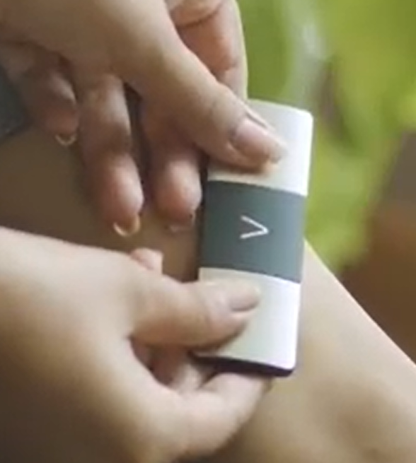
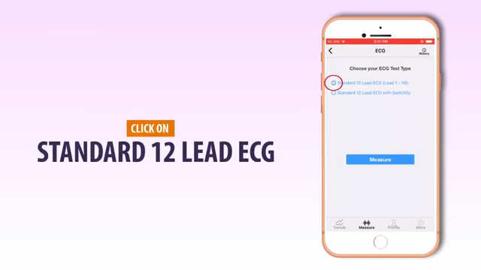
Case Study: Apple’s ECG Watch
Workings
Generates a single-lead (or Lead I) ECG.
A single-lead ECG is able to provide information about heart rate and heart rhythm and enables classification of AFib.
single-lead ECG cannot be used to identify conditions like heart attacks.
ECG app to accurately classify an ECG recording into AFib (98.3% accuracy) and sinus rhythm (99.6% accuracy).
Kardia Workings
It has two electrodes on the top for your fingers, and one on the bottom to contact the skin of your left leg.
So one have to touch it with two thumbs and touch the bottom via left leg
It generates 6Leads
It delivers EKG leads I, II, III, aVL, aVR, and aVF.
Sanket’s 12 Lead ECG
Can generates 12lead Ecg
Complicated & may not be possible easily to do ECG (anywhere)
Slight misplacement can cause errors
Showing working of apple series 4, Kardia 6L, Sanket’s 12L watch
Source:apple.com

Slide 9
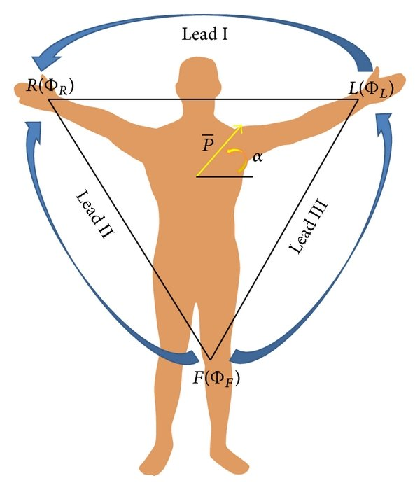
Constraints (WATCH)
From Two thumbs you can get Lead I
From Two thumbs + Left Leg (or lower left abdomen ) we can get II,III and aVF,aVR,aVL
From Touching points at Chest we can get rest Leads
TARGET
WATCH (ECG + Heart-Beat)
CHEST LEADS ❌
LEADS I ✔️
LEADS II, III (May be if touched leg) 💡 (If then can have aVL, aVF, aVR)
Different Leads shows
II, III, and aVF: inferior surface of the heart
V1 to V4: anterior surface
I, aVL, V5, and V6: lateral surface
V1 and aVR: right atrium and cavity of left ventricle
Without touching different body parts (like leg/chest) we cannot have any leads other than Lead I
Continuous ECG cannot be done as one have to keep circuit completed everytime so one need to touch both hands
Body Surface Potential Mapping
Source: Clinical Arrhythmology and Electrophysiology (Third Edition), 2019

Slide 10
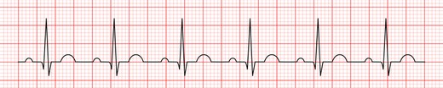
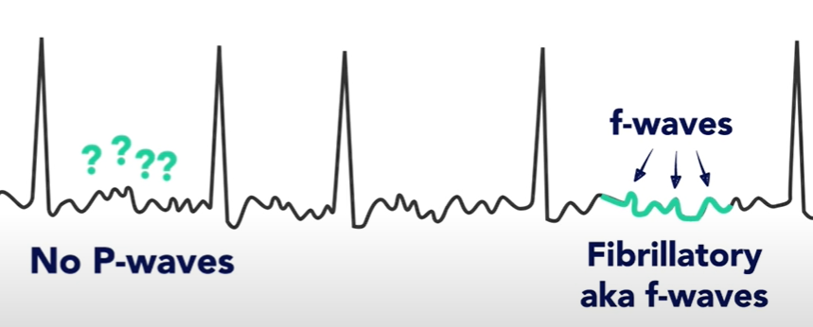
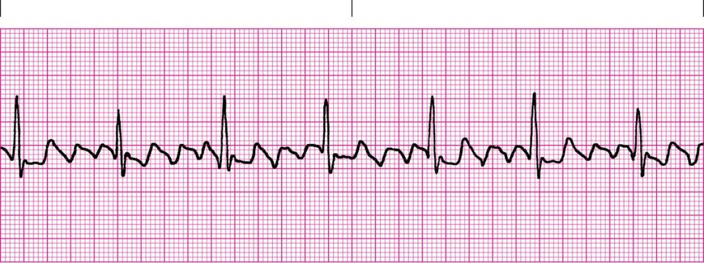
Constraints (WATCH)
TARGET
Get leads I, interpret ECG
Normal Sinus Rhythm ✔️
The P wave is upright in leads I and II
Each P wave is usually followed by a QRS complex
The heart rate is 60-99 BPM
Atrial Fibrillation ✔️
Lead I, Narrow QRS Complex, Irregular RR interval
f (fibrillatory) waves
No distinct P waves
Atrial Flutter ✔️
Lead I, Narrow QRS Complex, Regular RR interval
f (fibrillatory) waves
No distinct P waves
Low/High Heart Rates ✔️
From ECG RR intervals heart rate can be calculated
Normal Sinus Rhythm
Atrial Fibrillation
Atrial Flutter
Source:Sinus Rhythm
nottingham.ac.uk

Slide 11
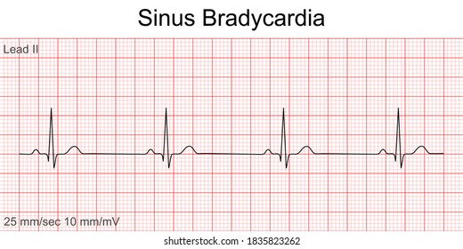
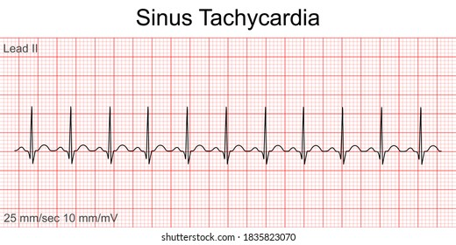
Constraints (WATCH)
Sinus Bradycardia ✔️
Rate < 60 BPM
Regular intervals
P wave present normal
PR interval & QRS width normal
Sinus Tachycardia ✔️
Rate > 100 BPM
Regular intervals
P wave present normal
PR interval & QRS width normal
Cardiac Axis (💡 MAYBE)
Normal Axis Deviation
Lead II has most +ve deflection compared to leads I and III.
Left Axis Deviation ( -30° to -90°)
Lead I has most +ve deflection.
Leads II and III are –ve .
Right Axis Deviation
Lead III has most +ve deflection and lead I should be –ve.
Sinus Bradycardia
Sinus Tachycardia
Leads | Normal Axis | Right Axis Deviation | Left Axis Deviation
Lead I | +ve | -ve | +ve
Lead II | +ve | +ve/-ve | -ve
Lead III | +ve/-ve | +ve | -ve
Source:Sinus Rhythm
nottingham.ac.uk

Slide 12
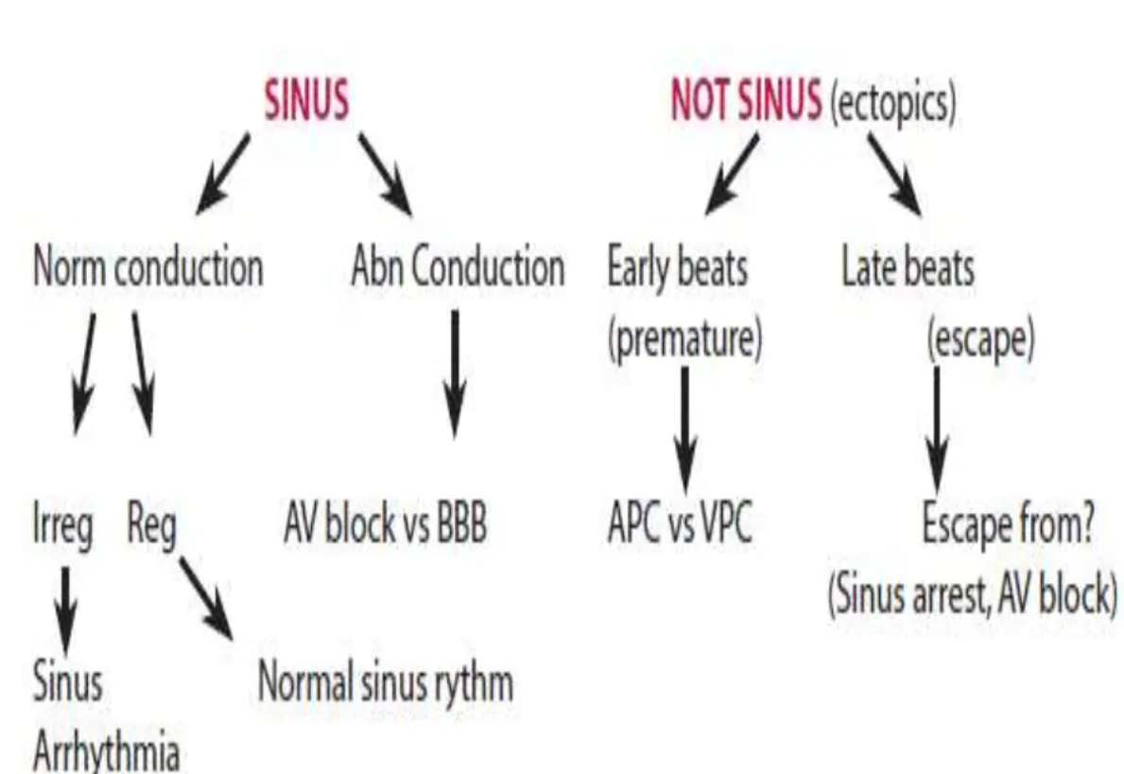
Constraints (WATCH)
Glossary:
APC: Atrial Premature Contractions
VPC: Ventricular Premature Contractions
BBB: Bundle Branch block
Ectopic: something that is in an odd place or position.
If we have 12 Leads of ECG we can detect all of them
If we have single lead we can detect only pace and some irregularities like arrythmia
Various rhythms possible
Source: Simplified Pediatric Electrocardiogram Interpretation April 2010 Clinical Pediatrics

Slide 13
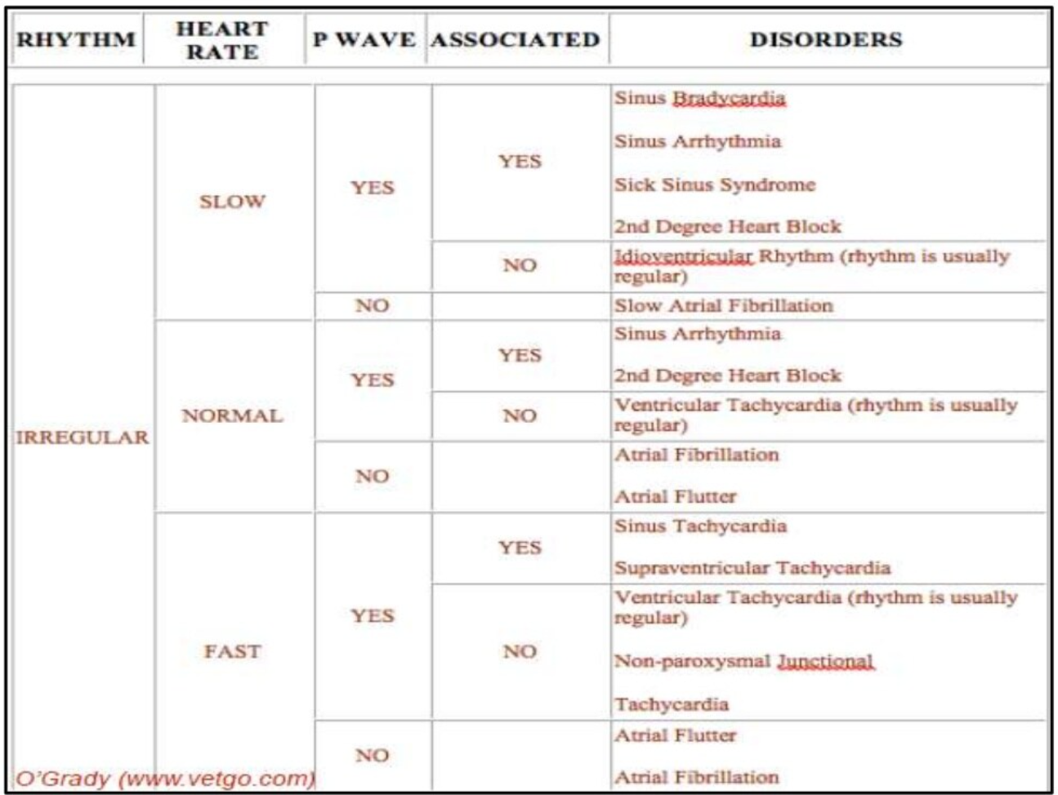
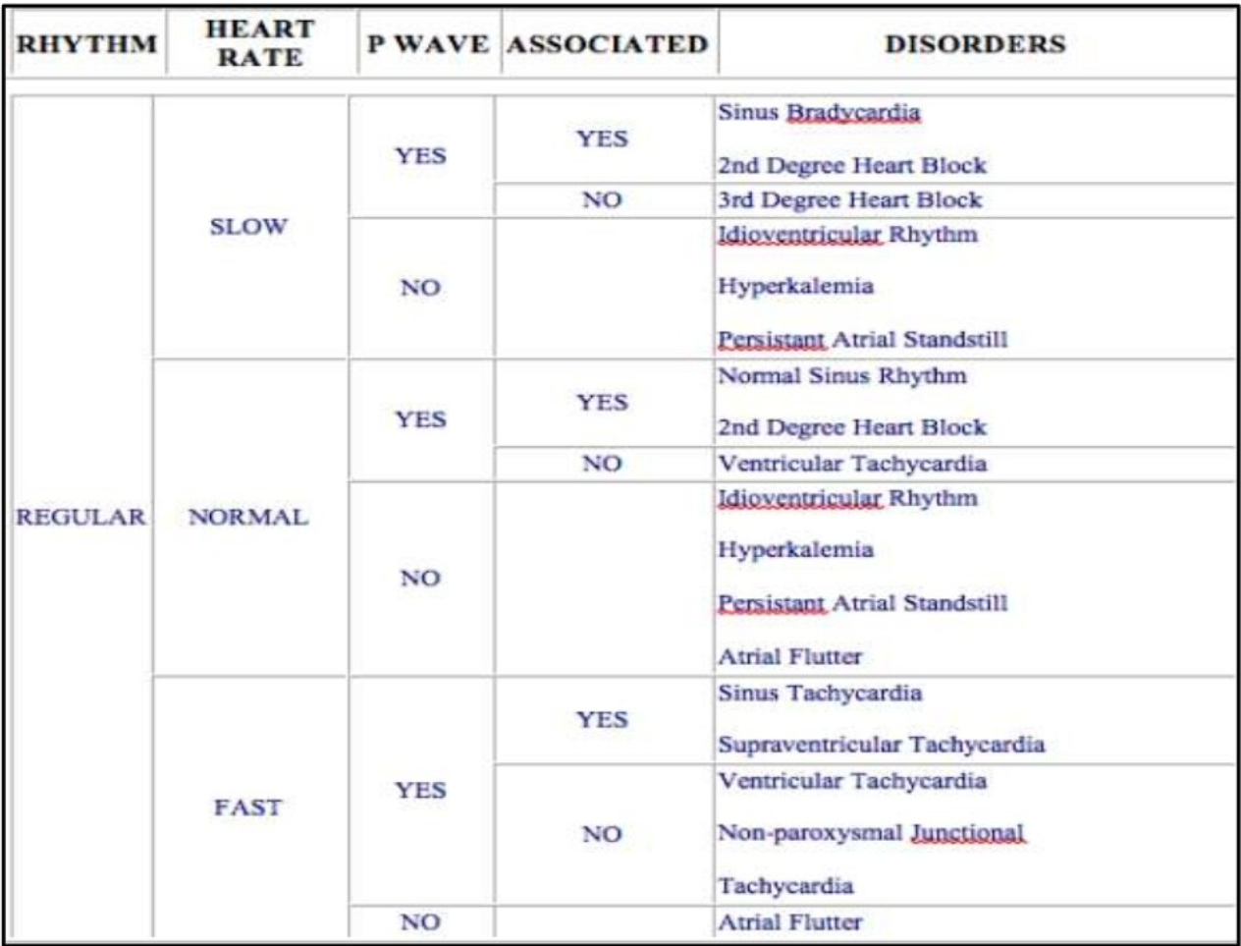
Constraints (WATCH)
Various rhythms possible
Source: Simplified Pediatric Electrocardiogram Interpretation April 2010 Clinical Pediatrics

Slide 14
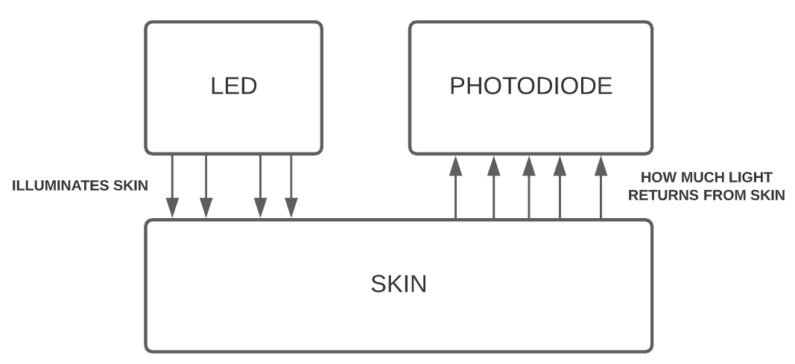
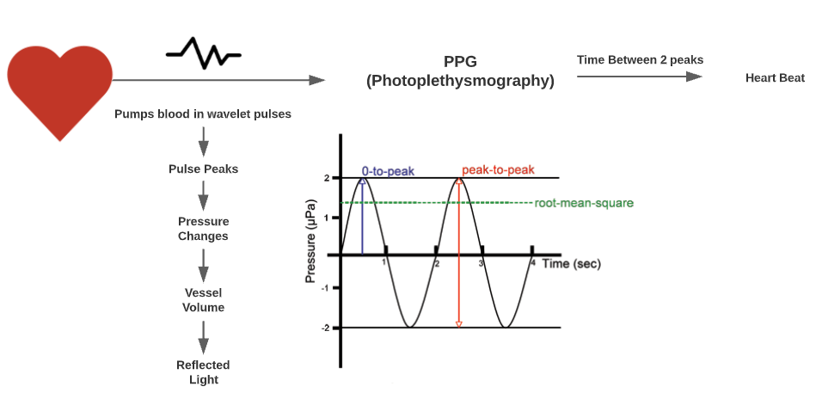
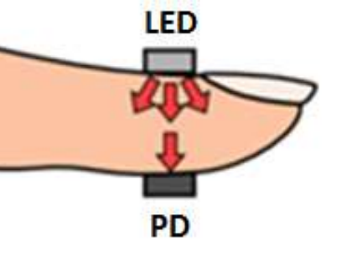
Working Principle: Heart Beat Sensor
A basic heart sensor works on the principle of photoplethysmography.
Plethysmography is a measurement technique that can be used to measure the volume changes in different parts of the body.
A plethysmograph is an instrument for measuring changes in volume within an organ or whole body
Two modes :
Transmissive mode - fingers / toes / earlobe
Reflective - forehead / cheek
The shorter wavelengths of light are strongly absorbed by melanin, Red and near-IR light passes easily.
Eg: Oximeter Sensor
Source: Biomedical Signal Processing and Control, BIOMED Jouranl Elsevier

Slide 15
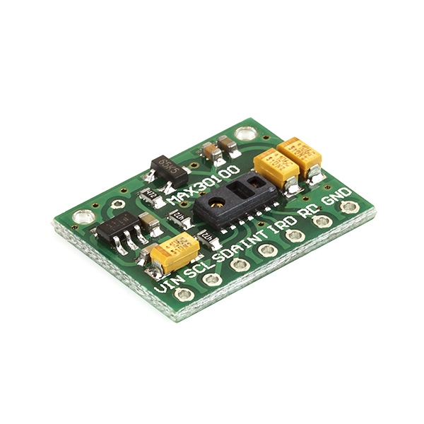
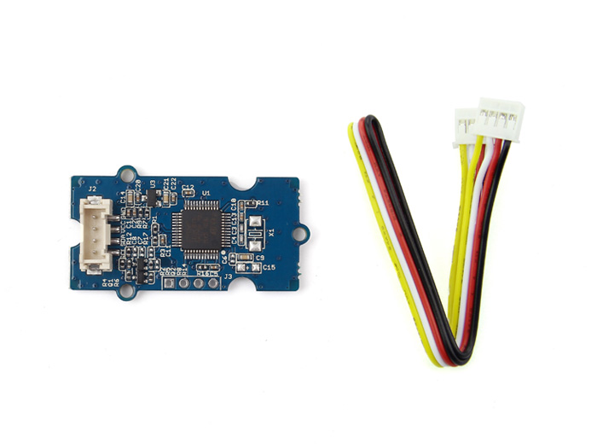
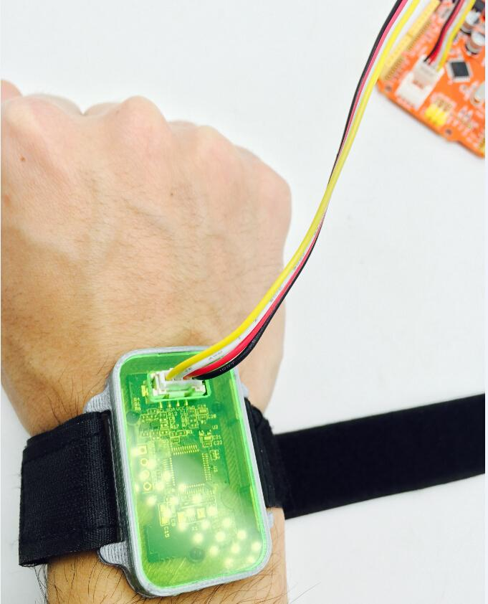
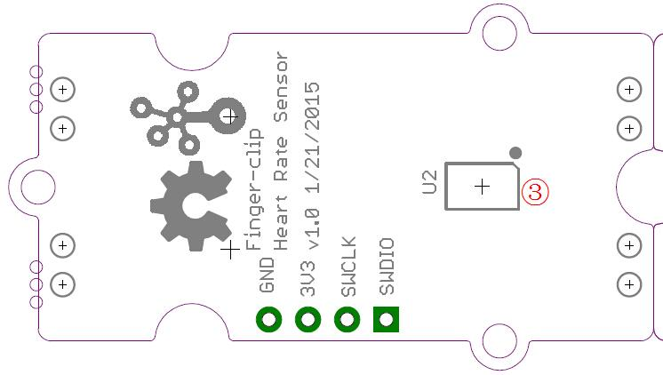
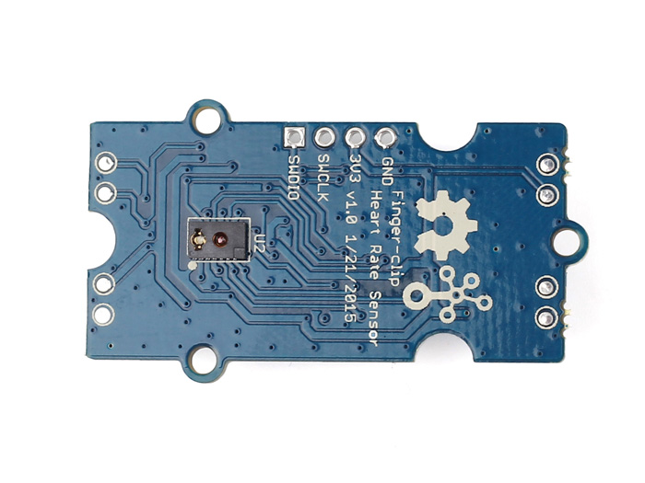
Heart Rate Sensor
Sensor MAX30100: Oximeter Sensor ❌
It’s an integrated pulse oximetry and heart-rate monitor sensor solution.
It works on the principle of photoplethysmography.
It combines two LEDs, a photodetector, optimized optics, and low-noise analog signal processing to detect pulse oximetry and heart-rate signals.
But we shouldn’t use this as the sensor height is lower than other components of the circuit.
Grove Finger-Clip Heart Rate Sensor ✔️
Base has the sensor same as Oximeter sensor and no other components on its base
So can be used easily assuming no size constraints initially
NeuroSky CardioChip
They only share data with large commercials
Very small
No data publicly available
Sensor MAX30100
Glove Finger-Clip Heart Rate Sensor

Slide 16
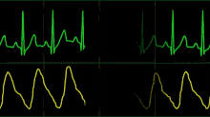
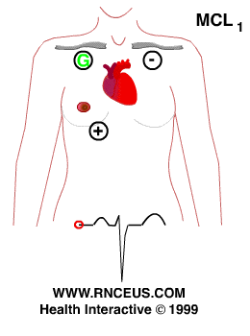
Working Principle
ECG is a technique for gathering electrical signals which are generated from the human heart.
When someone experiences physiological arousal then the ECG sensor allows to recognize level.
No electricity is sent into the body.
Stimulation of a muscle alters the electrical potential of the muscle fibres. (Cardiac cells), have property automaticity, which has capacity to spontaneously initiate impulses. These are then transmitted from cell to cell by gap junctions that connect cardiac cells to each other.
The electrical impulses spread through the muscle cells because of changes in ions.
Depolarisation and Repolarisation waves represent an electrical current and can be detected by placing electrodes on the surface of the body.
After the current has spread from the heart through the body, the changes are picked up by the ECG machine and the activity is recorded. The current is transmitted across the ECG machine at the selected points of contact of the electrode with the body
ECG records these impulses to show how fast the heart is beating, the rhythm of the heart beats (steady or irregular), and the strength and timing of the electrical impulses as they move through the different parts of the heart. Changes in an ECG can be a sign of many heart-related conditions.

Slide 17
Working Principle
Φ is potentials at different regions
Lead I: 𝑉_{I} = Φ_{L −} Φ_{R}
Lead II: 𝑉_{II} = Φ_{𝐹 −} Φ_{R}
Lead III: 𝑉_{III} = Φ_{𝐹 −} Φ_{𝐿}
On completing the circuit by touching Left and Right thumbs or arms we can get Lead I.
𝑎𝑉F = Φ_{𝐹} − (Φ_{𝐿} + Φ_{𝑅})/2
𝑎𝑉L = Φ_{L} − (Φ_{F} + Φ_{𝑅})/2
𝑎𝑉R = Φ_{R} − (Φ_{F} + Φ_{L})/2
Cardiac Axis = ± tan⁻¹ (𝑎𝑉𝐹/V_{I} )
When circuit completes by touching any two points then we can get potential difference between any two points defining it to give Lead I, II, III, etc
Body Surface Potential Mapping
Source: Clinical Arrhythmology and Electrophysiology (Third Edition), 2019

Slide 18
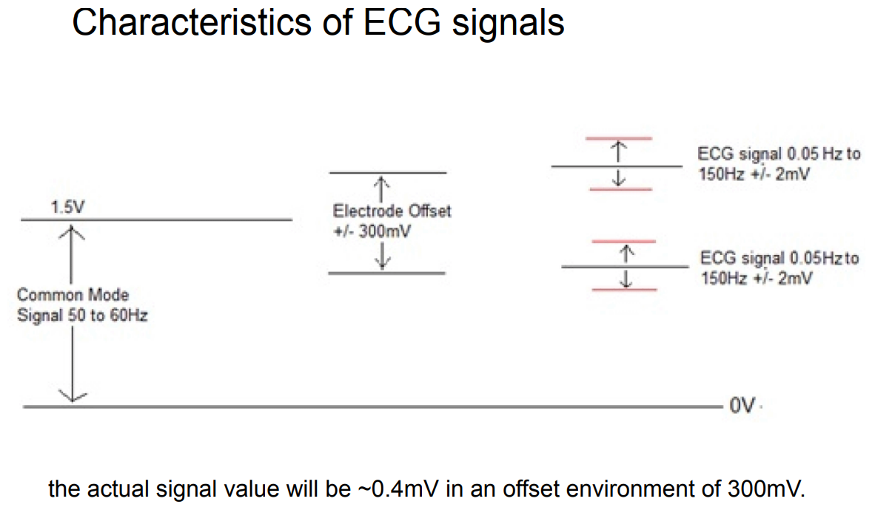
Work Principle
Output Analog Voltage ECG signals may vary from person to person.
The front end of an ECG must be able to deal with extremely weak signals ranging from 0.5 mV to 5.0 mV
DC component of up to ±300 mV, resulting from the electrode-skin contact
And a common-mode component of up to 1.5 V, resulting from the potential between the electrodes and ground.
Useful bandwidth of an ECG signal depends on the application
range from 0.5 Hz to 50 Hz—for a monitoring application in intensive care units
Uto 1 kHz for late-potential measurements (pacemaker detection).
A standard clinical ECG application has a bandwidth of 0.05 Hz to 100 Hz.
ECG Range
Source:elentra.healthsci.queensu.ca

Slide 19
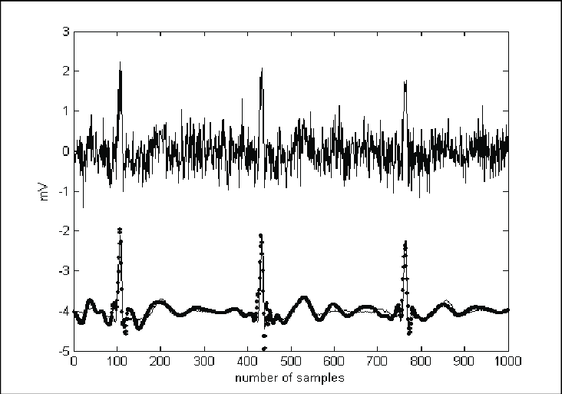
Sources of Noise
Source of Noise
Baseline wander caused by patient respiration (low frequency AC signal noise)
Power line interference ( 50-60Hz noise from power lines)
Muscle noise (This noise is very difficult to remove as it is in the same region as the actual signal. It is usually corrected in software.)
Other interference (i.e., radio frequency noise from other equipment)
Removal of Common Mode Noise
Use instrumentation amplifiers with very high common mode rejection ratios on the order of 100dB
Drive the patient body with an inverted common mode signal.
Apply software algorithms after acquisition for the removal of noise
ECG Noise
Source:elentra.healthsci.queensu.ca

Slide 20
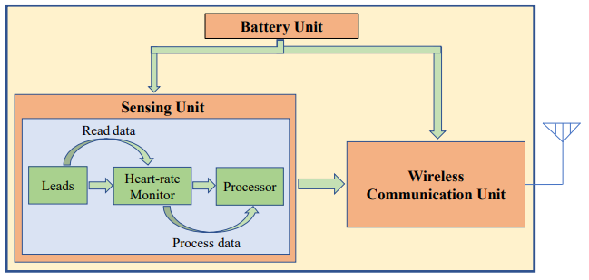
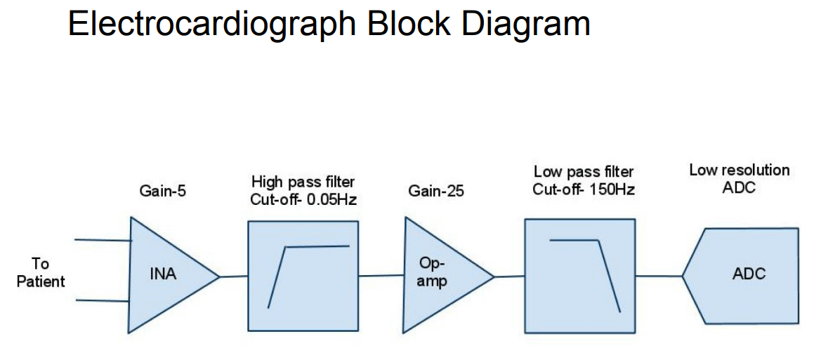
Block Diagram
Figure shows the block diagram that can be implemented on a circuit box as watch.
It should contain total of three units:
Battery Unit (Power Source)
Sensing Unit
Wireless Communication Unit
Sensing Unit
should capture leads
Monitor heart rate
Process them like passing wave via various electrical circuits like amplifier or band pass filters, and denoising the final output signal
Then Analog signals are converted to digital signals and sent to Wireless Unit
Wireless Communication Unit
Output data generated from sensing unit should be transferred to mobile application using the wireless may be wifi/Bluetooth/internet cloud channels
Block Diagram of a ECG device
Source: Mobile-based Tele-ECG for rural health care

Slide 21
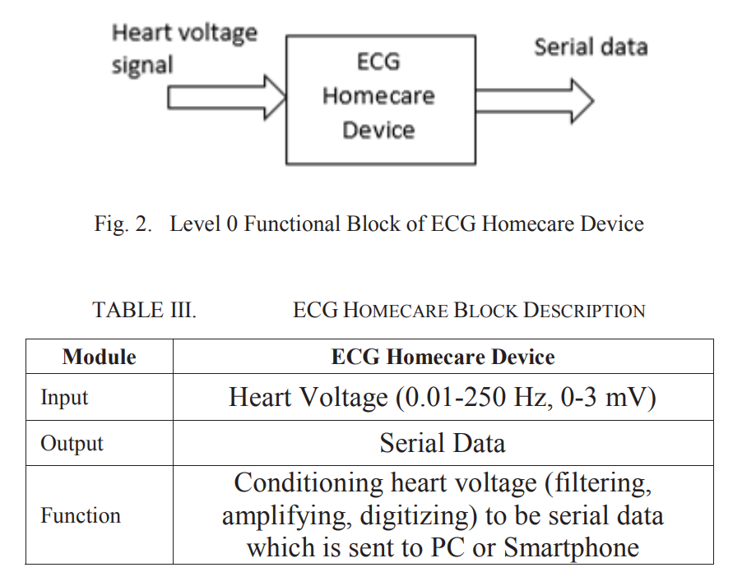
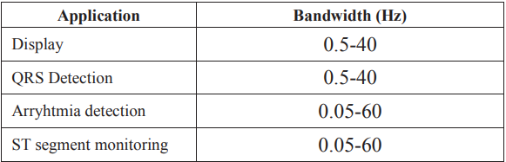
Block Diagram
Input analog signal contains electrical output from heart with voltage range from 0 mV to 3 mV and frequency range from 0.01 Hz to 250 Hz
Output signal will contain a digital serialized data converted from analog signals.
Process can be done on ECG device , process like filtering, amplifying and digitalizing can be done and will be sent to PC or smartphone device
Further processing can be done to detect and predict from different wave signals like QRS detection requires Bandwidth of 0.5Hz to 40Hz and arrythmia is detected with 0.05 Hz to 60Hz
Source:Design_of_ECG_Homecare12-lead_ECG, IEEE

Slide 22
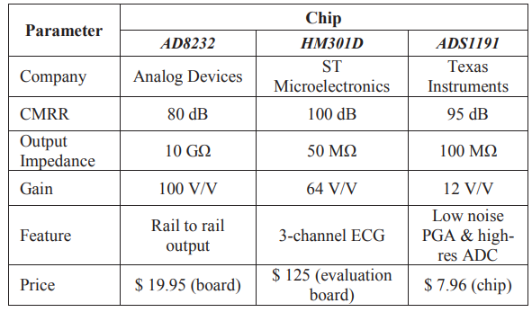
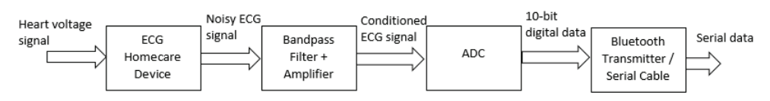
Block Diagram
There are a number of available analog front end (AFE) ECG chips available in the market.
AD8232 is preferred over another chips.
HM301D is three channel, while we only need single channel ECG.
ADS1191 doesn’t provide high enough gain to get good resolution.
AD8232 has the best output impedance and gain.
This is the final flow diagram that will be used in further circuits
Source:Design_of_ECG_Homecare12-lead_ECG, IEEE

Slide 23
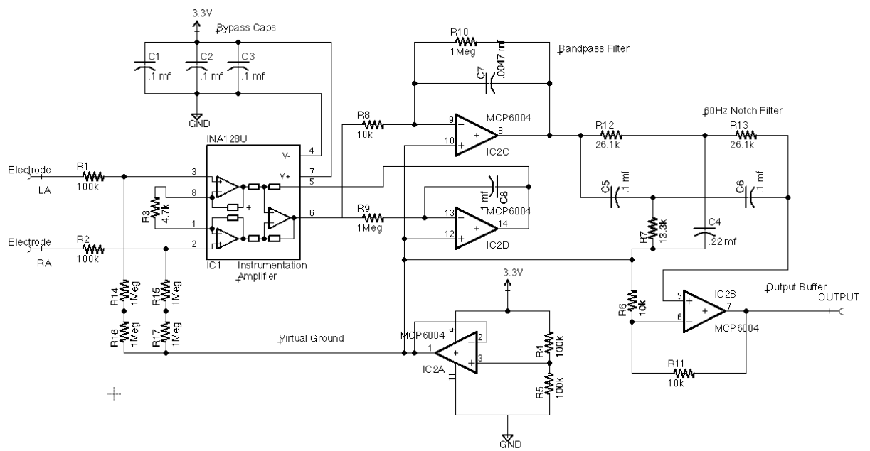
HD1: Circuit Diagram
Source:courses.cs.washington.edu

Slide 24
HD1: Circuit Diagram
Source:courses.cs.washington.edu

Slide 25
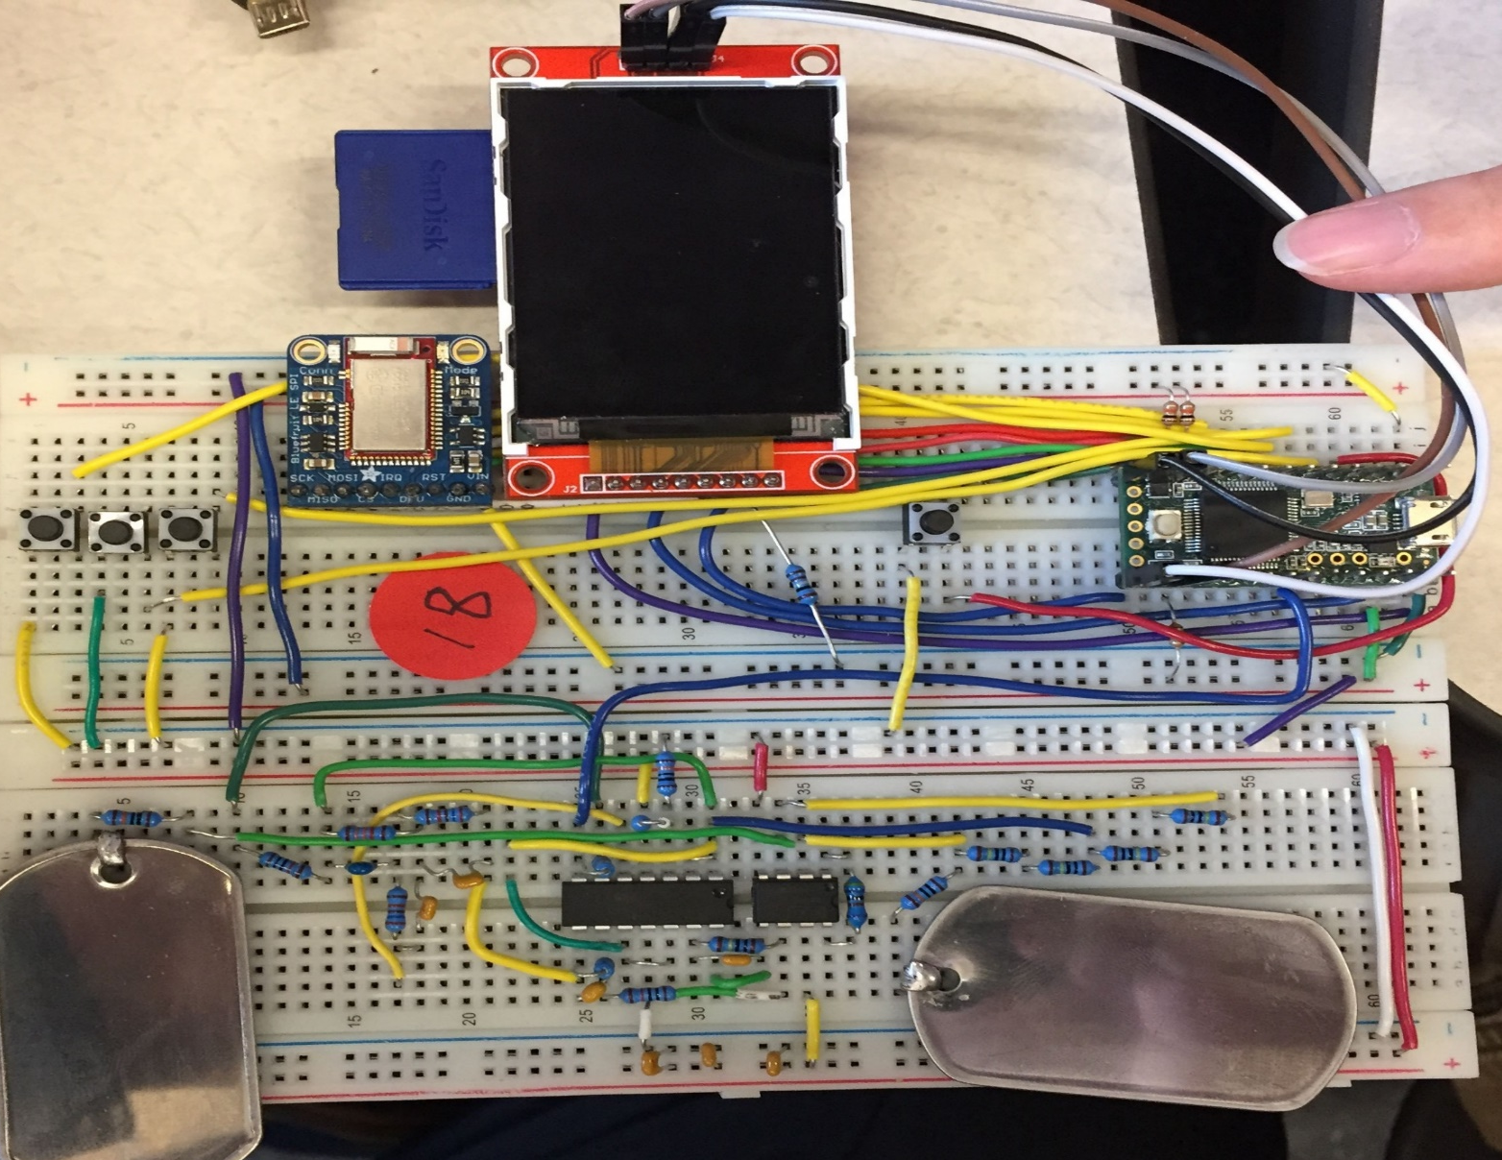
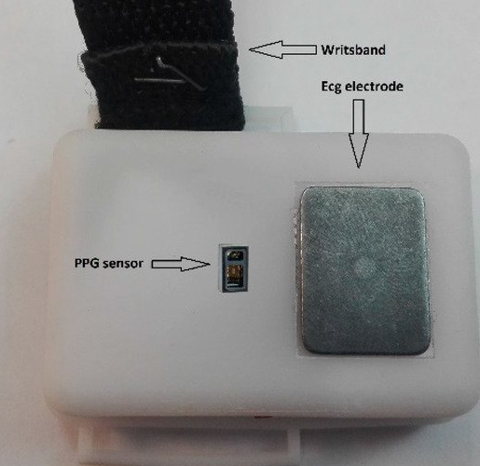
HD1: Circuit Diagram
Source:courses.cs.washington.edu
Source:courses.cs.washington.edu

Slide 26
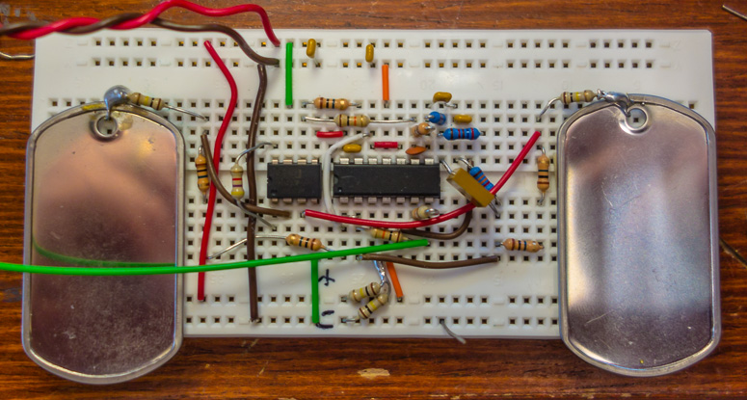
HD1: Circuit Diagram
3.3v
R2
GND
R9
R1
R8
R10
8 7 6 5
14 13 12 11 10 9 8
ELECTRODE 2
R15
INA128U
MCP6004
R14
ELECTRODE 1
R3
1 2 3 4 5 6 7
1 2 3 4
R11
R17
R6
R16
R4
R5
Source:courses.cs.washington.edu

Slide 27
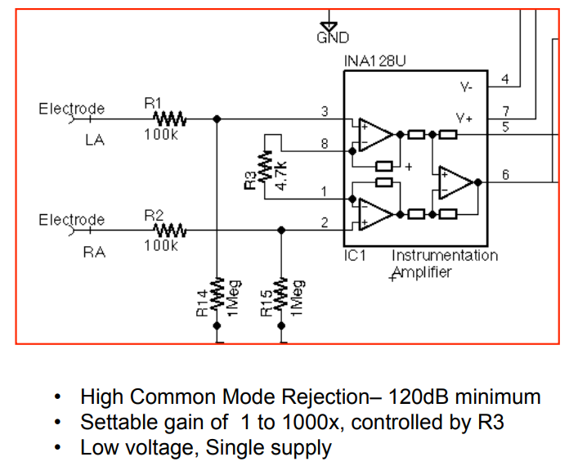
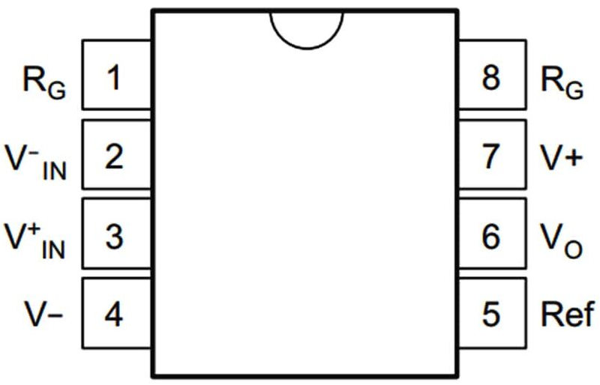
HD1: Circuit Diagram
Instrumentation Amplifier
Amplifier is a circuit that has a power gain >1
It can either be a separate piece of equipment or an electrical circuit contained within another device.
INA128U ( Texas Instruments )
It’s a low-power, general purpose instrumentation amplifiers offering excellent accuracy.
The versatile 3-op amp (8pins) design and small.
Source:courses.cs.washington.edu

Slide 28
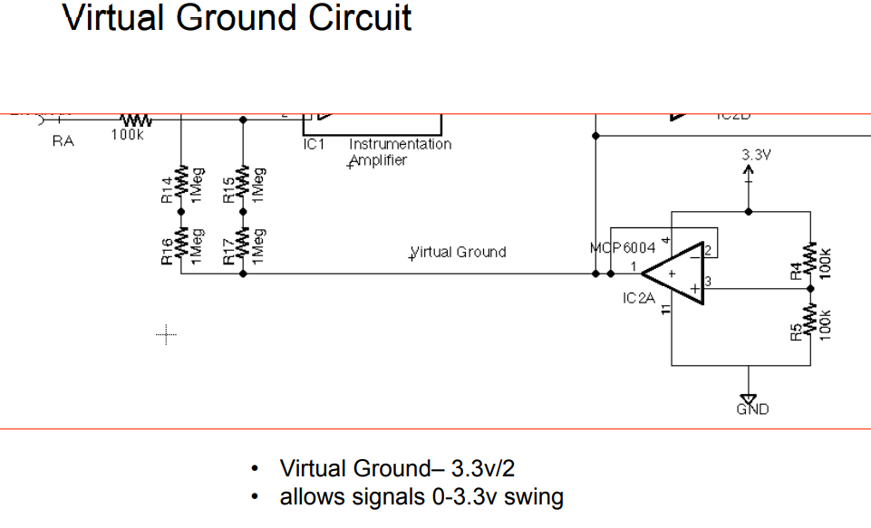
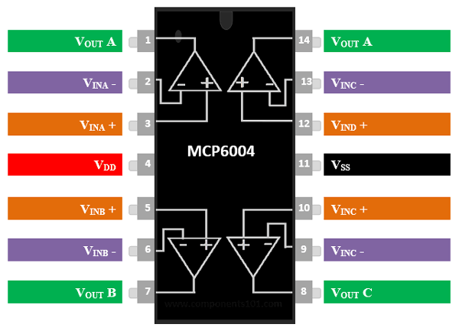
HD1: Circuit Diagram
Ground Circuit
3.3V as power source
Ground as 0 V
Op-Amp
Operational amplifier is DC-coupled high-gain electronic voltage amplifier with a differential input and, usually, a single-ended output.
Op-amps are known for their low power and high bandwidth gain.
MCP6004
It’s a Quad Op-amp (14-Pin) package.
It’s a quad general purpose op amp offering rail-to-rail input and output over the 1.8 to 6V operating range.
This amplifier has a typical gain–bandwidth product (GBWP) of 1 MHz with current only 100 microamperes.
The MCP6004 is available in 14-lead PDIP, SOIC and TSSOP packages
Source:courses.cs.washington.edu

Slide 29
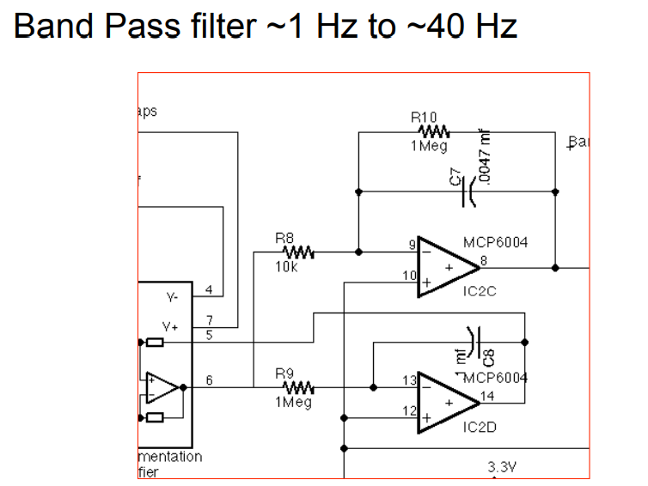
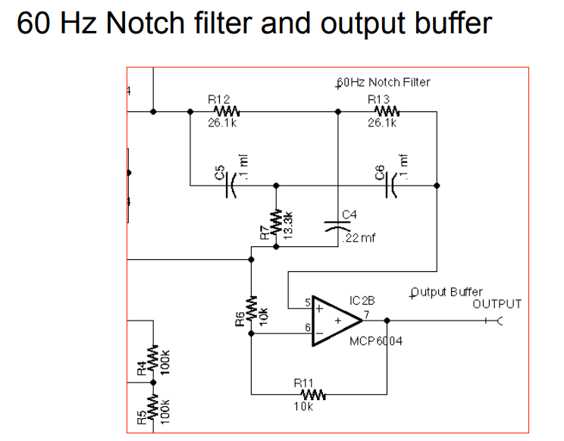
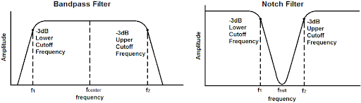
HD1: Circuit Diagram
Band-pass filter
It allows frequencies within a certain range and rejects (attenuates) frequencies outside that range
Here range used is 1Hz to 40Hz signals are allowed
Notch filter
Band-Stop filter, attenuates frequencies within a range while passing other frequencies unaltered.
Range of frequencies is very narrow.
Range of frequencies that is attenuated is stopband.
Source:courses.cs.washington.edu

Slide 30
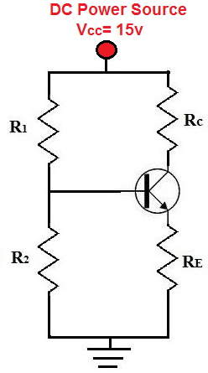
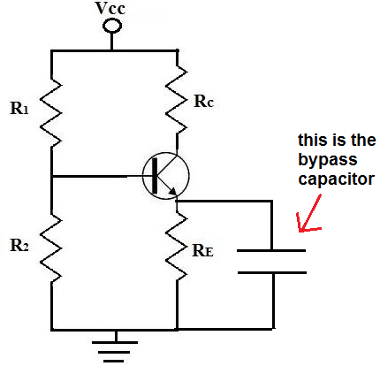
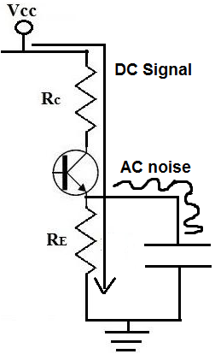
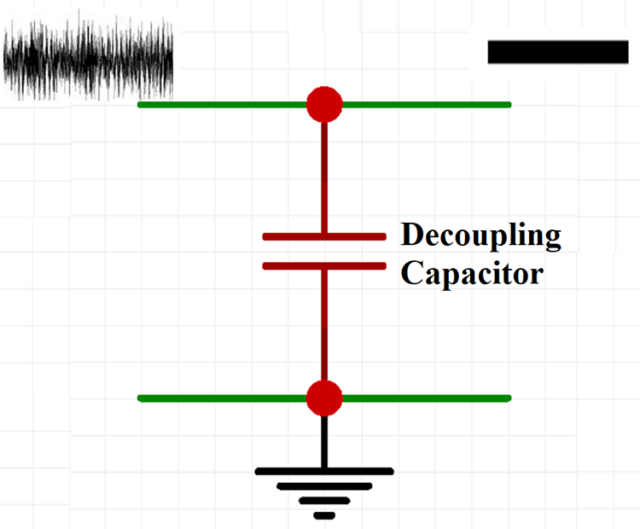
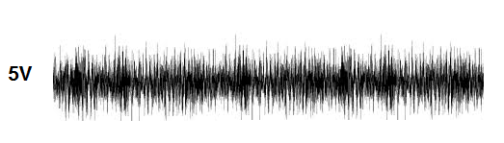
HD1: Circuit Diagram
Bypass capacitor
It shorts AC signals to ground, so that any AC noise that may be present on a DC signal is removed, producing cleaner DC signal.
The value of the bypass capacitor should be at least 1/10th of the resistance across the emitter resistance, RE at the lowest frequency intended to be bypassed.
Source:components101.com

Slide 31
HD1: Cost Estimation
Teensy 3.2 ( 2200 Rs)
INA128U Op-Amp ( 1400 Rs )
Resistors, Capacitors & Wires ( 500 Rs )
NodeMCU ( 400Rs )
MCP6004 Op-Amp ( 140 Rs )
Electrode ( 100Rs )
Breadboard ( 70Rs )
==========
4810 Rs
Grove Finger-Clip Heart 4810+2359 Rs =7169 Rs (OPTIONAL)

Slide 32
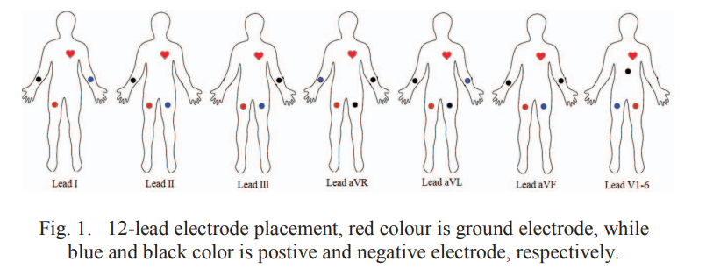
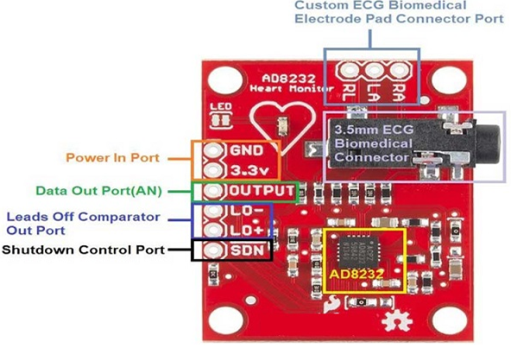
HD2: Circuit Diagram
By using AD8232 ECG system and changing positions of electrodes present we can get all 12 Leads ECG signal using 4 electrodes and simple setup.
AD8232
It’a an integrated signal conditioning block for ECG and other biopotential measurement applications.
It extract, amplify, and filter small biopotential signals in the presence of noisy conditions, such as those created by motion or remote electrode placement.
This design allows for an ultralow power analog-to-digital converter (ADC) to acquire the output signal easily.
It has two-pole high-pass filter for eliminating motion artifacts and the electrode half-cell potential.
This filter is tightly coupled with the instrumentation architecture of the amplifier to allow both large gain and high-pass filtering in a single stage, thereby saving space and cost.
Source:Design of ECG Homecare:12-Lead ECG Acquisition

Slide 33



HD2: Circuit Diagram
Source:Towards IoT and ML Driven Cardiac Status Prediction System

Slide 34


HD2:Circuit Diagram
Arduino & AD8232 ❌
Nodemcu(WiFI Module) & AD8232 ✔️
Source:tinkercad.com

Slide 35
HD2:Cost Estimation
AD8232 ECG System ( 550 Rs )
NodeMCU ( 400Rs )
Jumper Wires & Breadboard ( 50 Rs )
=============
1000 Rs
=============
Grove Finger-Clip Heart 1000+2359 Rs =3359 Rs (OPTIONAL)

Slide 36

Data Collection
Reference taken from
AliveCor-AF Classification from a short single lead ECG recording: the PhysioNet/Computing in Cardiology Challenge 2017
Needed Variety
Different Age
Different Time
Different Workouts
Different Temperature
Types of data that can be collected:
Technical Data
Amplitude(in mV) v/s time plot
Heart Rate
Actual Afib, tachycardia, etc data
Age
Gender
Food Habits
Any disease
Mental stress
Amplitude(in mV) v/s time plot
Plotted Sample data taken from physionet cardiology data

Slide 37

Process Flow
Stage 1
Can assemble a basic circuit system
Tweaking & Correction Checks
Stage 2 (Optional)
Convert two electrodes into single electrode one pressed over skin
Styling it as watch
Stage 3
Data Collection
Stage 4
Develop a mobile application (preferably Blynk)
Stage 5
Develop ML model

Slide 38
Resources
Design of ECG Homecare:12-Lead ECG Acquisition using Single Channel ECG Device Developed on AD8232 Analog Front End
Accessing the ECG Data of the Apple Watch and Accomplishing Interoperability Through FHIR (researchgate.net)
Taking an ECG with the ECG app on Apple Watch Series 4, Series 5, or Series 6 - Apple Support (IN)
CSE 466 Lab 7: Analog Front End for an Electrocardiograph (washington.edu)
CSE466 lectures (washington.edu)
True Unipolar ECG Machine for Wilson Central Terminal Measurements (researchgate.net)
A Novel Wearable Device for Continuous Ambulatory ECG Recording: Proof of Concept and Assessment of Signal Quality (nih.gov)
Electronics | Free Full-Text | Advances of ECG Sensors from Hardware, Software and Format Interoperability Perspectives (mdpi.com)
Comparison of Baseline Wander Removal Techniques considering the Preservation of ST Changes in the Ischemic ECG: A Simulation Study (hindawi.com)
Passive Detection of Atrial Fibrillation Using a Commercially Available Smartwatch | Atrial Fibrillation | JAMA Cardiology | JAMA Network
Comparison of Baseline Wander Removal Techniques considering the Preservation of ST Changes in the Ischemic ECG: A Simulation Study (hindawi.com)

Slide 39
Timeline
Points taken under consideration to create timeline
Total of 4months for BTP
15 days interval so 8 reviewal meets
Resolution
Hardware sensors
ML parameters
Datasets
Results Till (Tn) 2nd AUG 2021
Basic Analysis
Results After 15 days (Tn+15) 21st AUG 2021
Research paper review for ECG smartwatches
Devices Available
Publications
Market Statistics
Deep Analysis
Study of Sensors
Results After 30 days (Tn+30) 8^{th Sept 2021}
Hardware Analysis
Gather ECG datasheets available
Expected Results After 45 days (Tn+450) 24^{th Sept 2021}
Hardware Setup
How to collect data?
Data Collection
Mobile Application Setup
Final Ideation

Slide 40
Thank You!

Slide 41
Liquid used in ECG Slight changes in ECG Actually How & Why we are getting this graph? Verification FDI approval? Theranos Technical objection? Sensor?
POINTS TO CORRECT 2nd AUG
POINTS TO CORRECT 21ST AUG
2 pages

